Slide 1

REPUBLIC OF BULGARIA
Ministry of Education and Science
EEA Grants
Norway Grants
BG09 programme – EEA Scholarships Fund
Cooperation Committee meeting, 17th December 2015, Bergen

Slide 2
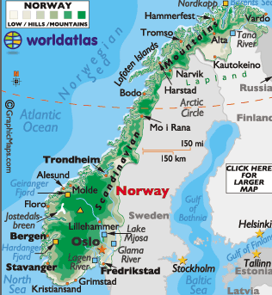
BG09 - Donor institutions:
Norway
16 HEIs total:
University of Oslo
University of Agder
University of Bergen
University of Tromso
University of Stavanger
University of Trondheim
NTNU
Norwegian University of Life Sciences
Norwegian School of Sport Sciences
Norwegian Business School
Norwegian Academy of Music
Nordland Research University
Arctic University of Norway
University College of Oslo and Akershus
Volda University College
University College of Buskerud and Vestfold

Slide 3
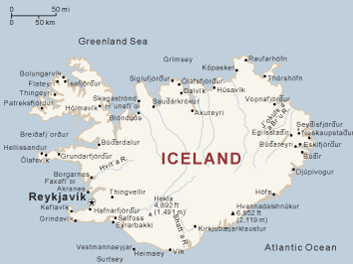
BG09 - Donor institutions:
Iceland
5 HEIs total:
University of Reykjavik
University of Iceland
Bifrost University
University of Akureiri
Agricultural University of Iceland

Slide 4
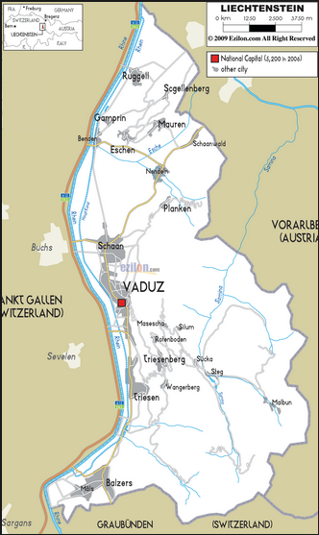
BG09 - Donor institutions:
Liechtenstein
2 HEIs total:
International Academy of Philosophy
University of Liechtenstein

Slide 5
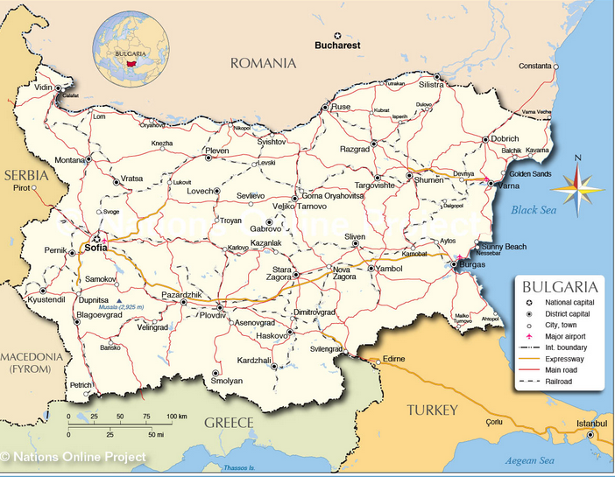
BG09 – BS institutions
20 HEIs out of 51 HEIs in total:
University of Sofia
University of Plovdiv
University of National and World Economy
University of Architecture, Civil Engineering and Geodesy - Sofia
Thracian University – Stara Zagora
Medical University – Plovdiv
Medical University – Varna
Medical University - Pleven
New Bulgarian University
Free University of Bourgas
University of Agriculture – Plovdiv
American University in Bulgaria
Higher School of Transport
University of Rousse
University of Economics – Varna
University of Shoumen
University of Food Technologies – Plovdiv
South-Western University of Blagoevgrad
Free University of Varna
Technical University of Sofia

Slide 6
BG09 – Subject distribution
Mobility Projects in Higher Education
Agriculture, Forestry, Fishery, and Veterinary
(4.60 %)
Health and Welfare
(14.47 %)
Services
(1.98 %)
Education (13.81 %)
Arts and Humanities
(9.21 %)
Engineering, Manufacture and Construction
(9.87 %)
Arts and Humanities
(9.21 %)
Social Sciences
(15.13 %)
ICT (2.64 %)
Natural Sciences, Mathematics and Statistics
(7.89 %)
ICT (2.64 %)
5 calls in total
152 projects funded
Business, Administration and Law
(20.40 %)

Slide 7
BG09 – Subject distribution
Interinstitutional Cooperation
Projects
Natural Sciences, Mathematics and Statistics
(2 projects)
Health and Welfare
(2 projects)
ICT (2.64 %)
ICT (2.64 %)
ICT (2.64 %)
ICT (2.64 %)
Engineering, Manufacture and Construction
(1 project)
ICT (2.64 %)
Agriculture, Forestry, Fishery, and Veterinary
(1 project)
1 call in total;
6 projects funded

Slide 8
BG09 – Levels of education participation
Higher Education:
Bachelor students;
Doctoral candidates;
Academic and administrative staff
Research:
Research and administrative staff

Slide 9
BG09 – Show case
Project: BG09-0001
“Methodologies and technologies for enhancing the motor and social skills of children with development problems”
Measure: Inter-institutional Cooperation Projects
Project budget: 125 890.96 €
Beneficiary: Institute of System Engineering and Robotics, Bulgarian Academy of Sciences
Partners:
University of Stavanger, Norway
The South-West University – Blagoevgrad, Bulgaria
Day care center for children in Bansko, Bulgaria
Day care center for children in Gotse Delchev, Bulgaria

Slide 10
BG09 – Show case
Project: BG09-0001
Rationale:
Play is fundamental and important for the development of children
Children with impairments have limitations in cognitive, motor, speech-language and communicative skills
Play is a medium that can enhance skills by joyful and self-stimuli
Project objective: to develop and implement an innovative model for ensuring the children with development problems or disabilities the possibility to play, on one hand for the sake of the play itself and on the other hand for the sake to play as a function for improvement of motor skills and social contacts of these children

Slide 11
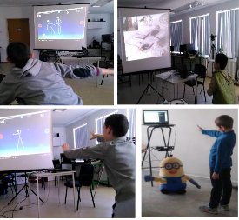
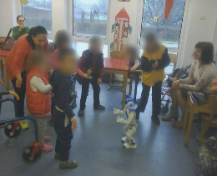
BG09 – Show case (cont.)
Project: BG09-0001 “Methodologies and technologies for enhancing the motor and social skills of children with development problems”
Target groups:
Children with development problems
and their parents
Speech therapists, psychologists, social workers
and special educators
Stakeholders
Main activities:
Adaptation and customization of computer games
to facilitate and enhance motor skills,
social interaction and verbalization
Development of innovative robotic and motion-sensing structured play for imitation, collaborative and cognitive skills
Piloting the proposed innovative methodologies and technologies with children with development problems
Expected results:
Development of new knowledge and skills
of research staff and therapists working with
children with development problems
Support for therapists by
assistive computerized and robotic technologies

Slide 12


Slide 13
Thank you
for your attention!
BG09 PO contact person: m.daneva@mon.bg
BG09-0001 Project Coordinator: alekova@fi.uio.no

